Slide 1
Instructor Materials
Chapter 7: IP Addressing
CCNA Routing and Switching
Introduction to Networks v6.0
Notes:
Cisco Networking Academy Program
Introduction to Networks v6.0
Chapter 7: IP Addressing

Slide 2
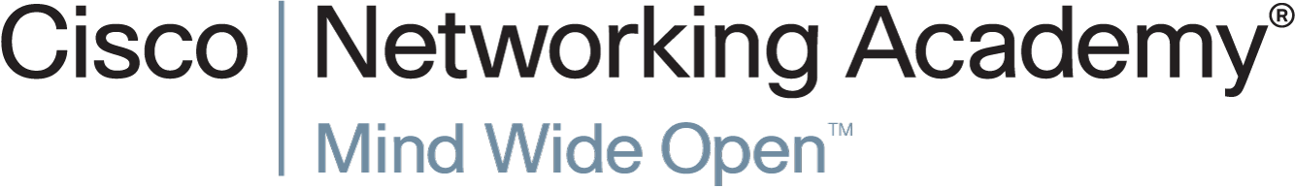

Slide 3
Chapter 7: IP Addressing
CCNA Routing and Switching
Introduction to Networks v6.0
Notes:
Cisco Networking Academy Program
Introduction to Networks v6.0
Chapter 7: IP Addressing

Slide 4
Chapter 7 - Sections & Objectives
7.1 IPv4 Network Addresses
  Convert between binary and decimal numbering systems.
  Describe the structure of an IPv4 address including the network portion, the host portion, and the subnet mask.
  Compare the characteristics and uses of the unicast, broadcast, and multicast IPv4 addresses.
  Explain public, private, and reserved IPv4 addresses.
7.2 IPv6 Network Addresses
  Explain the need for IPv6 addressing.
  Describe the representation of an IPv6 address.
  Describe types of IPv6 network addresses.
  Configure global unicast addresses.
  Describe multicast addresses.
7.3 Connectivity Verification
  Explain how ICMP is used to test network connectivity.
  Use ping and traceroute utilities to test network connectivity.
Notes:
4

Slide 5
7.1 IPv4 Network Addresses
Notes:
Cisco Networking Academy Program
Introduction to Networks v6.0
Chapter 7: IP Addressing

Slide 6
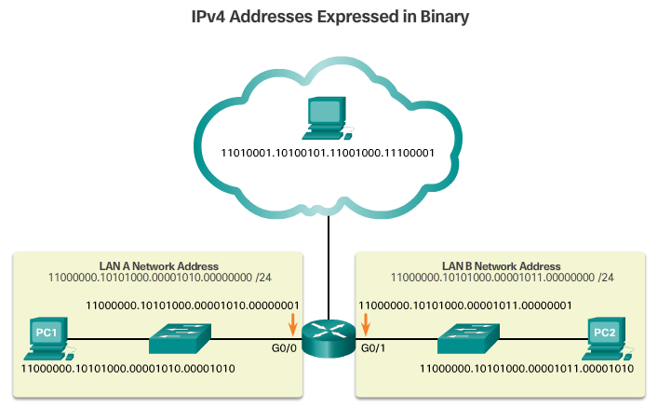
IPv4 Network Addresses
Binary and Decimal Conversion
Binary Numbers vs Decimal Numbers
  Binary is a numbering system that consists of the numbers 0 and 1 called bits. In contrast, the decimal numbering system consists of 10 digits consisting of the numbers 0 – 9.
  Binary is important for us to understand because hosts, servers, and network devices use binary addressing.
Notes:
7.1 – IPv4 Network Addresses
7.1.1 – Binary and Decimal Conversion

Slide 7
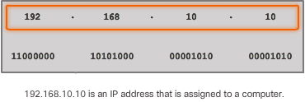
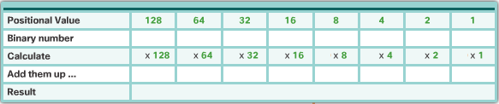
IPv4 Network Addresses
Binary and Decimal Conversion
IPv4 Addresses
  consists of a string of 32 bits, divided into four sections called octets.
  Each octet contains 8 bits (or 1 byte) separated with a dot.
  IPv4 addresses are commonly expressed in dotted decimal notation
Conversion between Binary to Decimal
  Use the chart to help with conversion
Dotted Decimal
1st
2nd
3rd
4th
octets
Notes:
7.1 – IPv4 Network Addresses
7.1.1 – Binary and Decimal Conversion

Slide 8
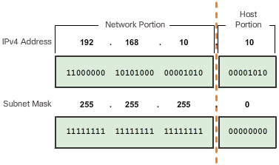
IPv4 Network Addresses
IPv4 Address Structure
The IP address gives a device a unique address over a network.
The Subnet Mask used to identify the network and host portion of an IPv4 address.
The 1s identify the Network portion and the 0s the Host portion.
1s is the Network
0s is the Host
Notes:
7.1 – IPv4 Network Addresses
7.1.2 – IPv4 Address Structure

Slide 9
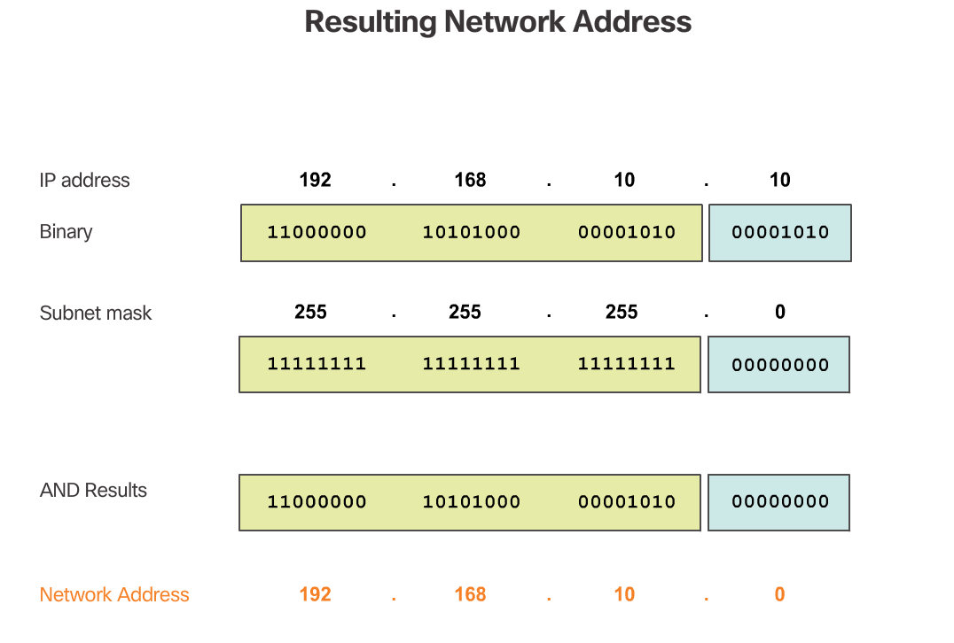
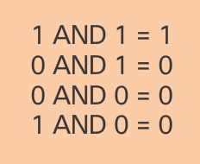
IPv4 Network Addresses
IPv4 Address Structure
Logical AND
  You can identify the network address to which an IPv4 address belongs.
Notes:
7.1 – IPv4 Network Addresses
7.1.2 – IPv4 Address Structure

Slide 10
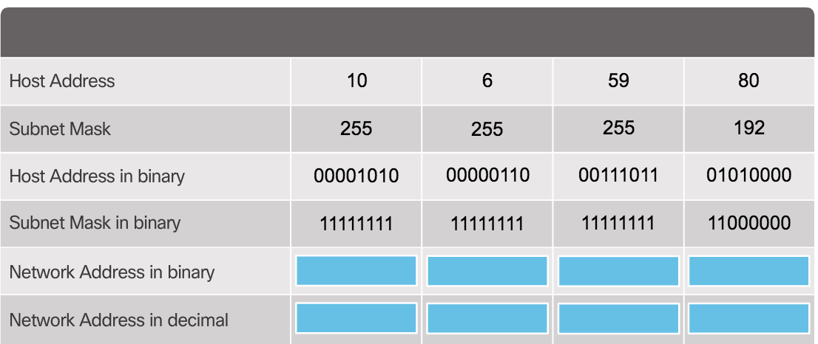
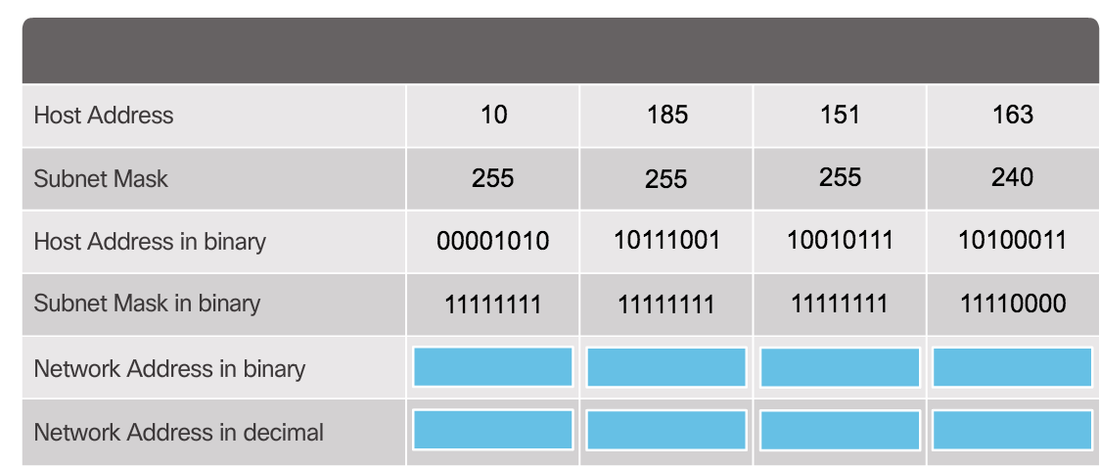
IPv4 Network Addresses
Activity ANDing
1
2
Notes:
7.1 – IPv4 Network Addresses
7.1.2 – IPv4 Address Structure

Slide 11
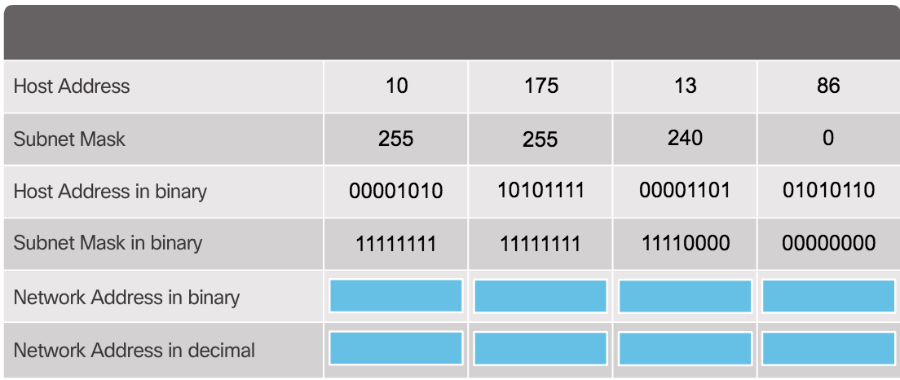
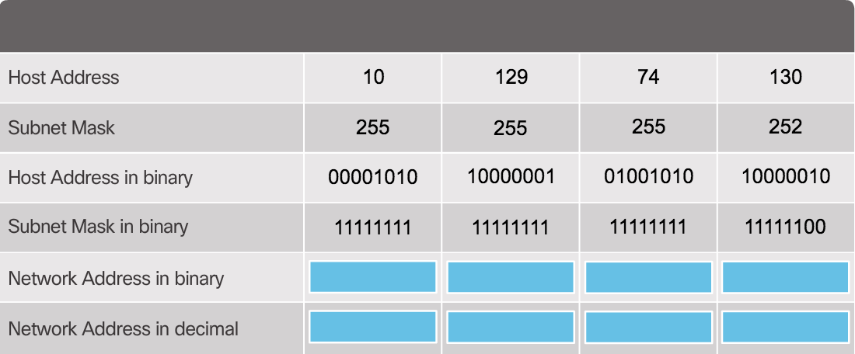
IPv4 Network Addresses
Activity ANDing
3
4
Notes:
7.1 – IPv4 Network Addresses
7.1.2 – IPv4 Address Structure

Slide 12
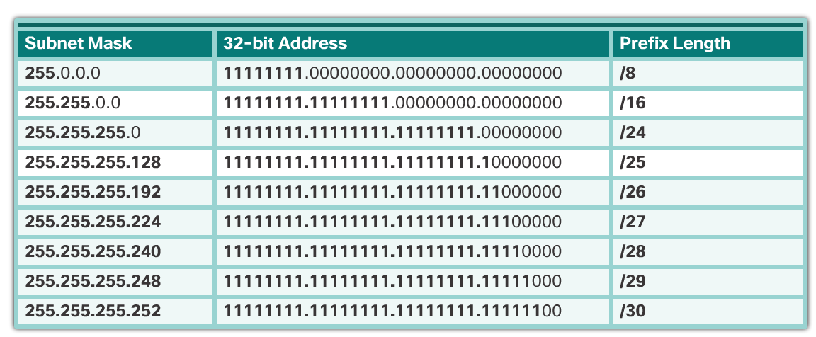
IPv4 Network Addresses
IPv4 Address Structure
Prefix Length
  is the number of bits set to 1 in the subnet mask. It is written in “slash notation”, which is a “/” followed by the number of bits set to 1. Therefore, count the number of bits in the subnet mask and prepend it with a slash.
Notes:
7.1 – IPv4 Network Addresses
7.1.2 – IPv4 Address Structure

Slide 13

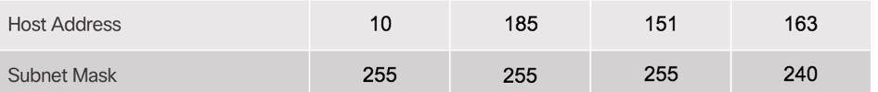
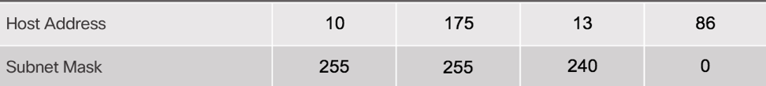
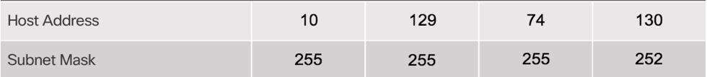
IPv4 Network Addresses
Prefix Length
What are the Prefix Length of the following IPv4 addresses?
1
2
3
4
Notes:
7.1 – IPv4 Network Addresses
7.1.2 – IPv4 Address Structure

Slide 14
IPv4 Network Addresses
IPv4 Networks, Hosts, and Broadcast
Given a 10.1.1.0/24 IPv4 address
  Network Address – 10.1.1.0
  First Host Address – 10.1.1.1
  Last Host Address – 10.1.1.254
  Broadcast Address – 10.1.1.255
Note: Normally, in practice the first host address is the
default gateway address. In this case the default gateway
is 10.1.1.1
Notes:
7.1 – IPv4 Network Addresses
7.1.3 – IPv4 Unicast, Broadcast, and Multicast

Slide 15
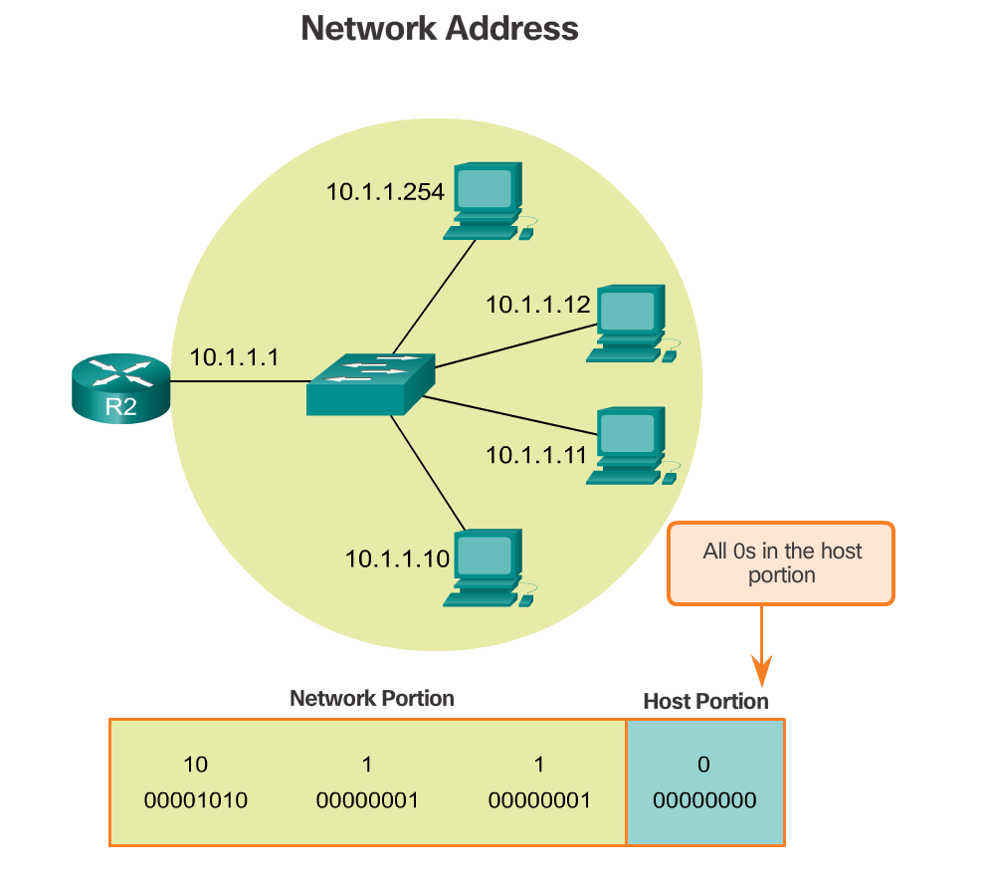
IPv4 Network Addresses
IPv4 Networks, Hosts, and Broadcast
Given a 10.1.1.0/24 IPv4 address
Notes:
7.1 – IPv4 Network Addresses
7.1.3 – IPv4 Unicast, Broadcast, and Multicast

Slide 16
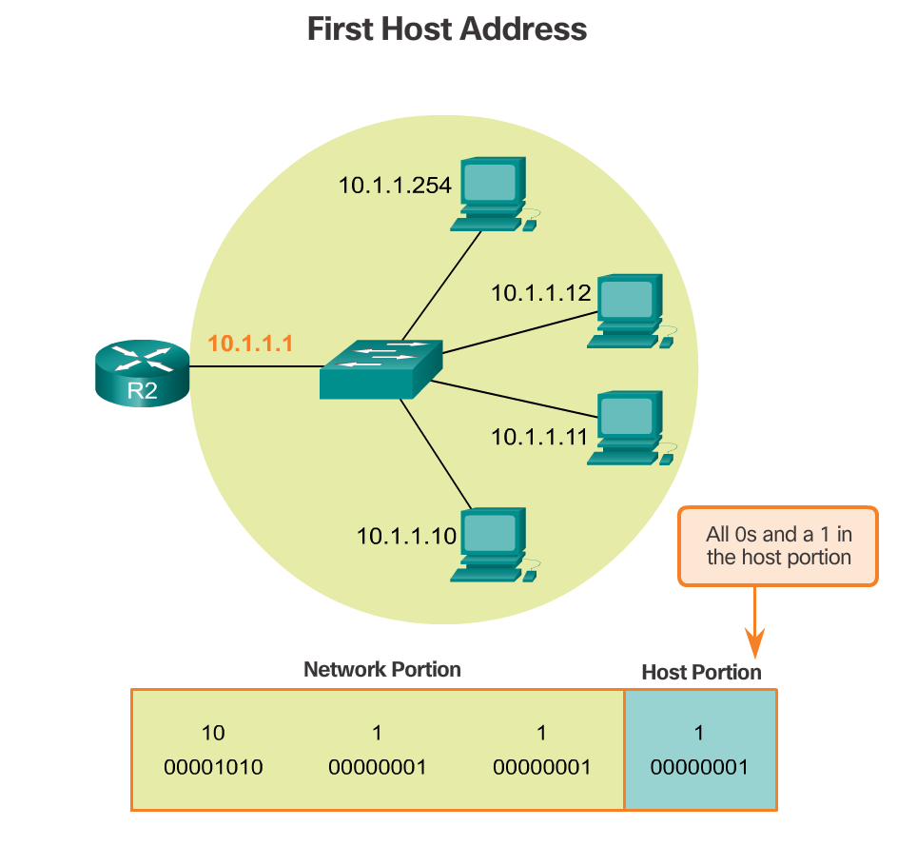
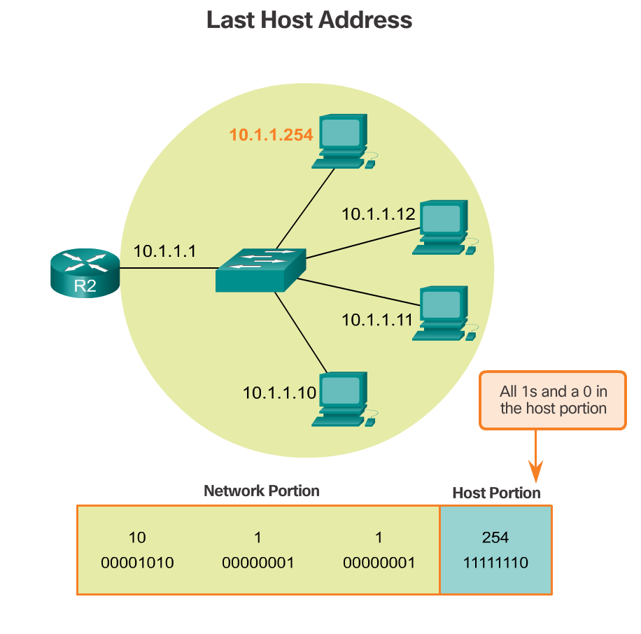
IPv4 Network Addresses
IPv4 Networks, Hosts, and Broadcast
Given a 10.1.1.0/24 IPv4 address
Note: 10.1.1.1 to 10.1.1.254 are the usable IP addresses
Notes:
7.1 – IPv4 Network Addresses
7.1.3 – IPv4 Unicast, Broadcast, and Multicast

Slide 17
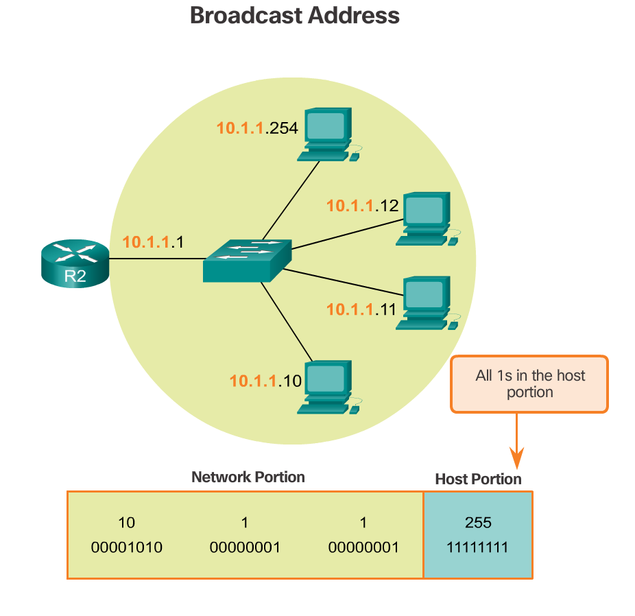
IPv4 Network Addresses
IPv4 Networks, Hosts, and Broadcast
Given a 10.1.1.0/24 IPv4 address
Notes:
7.1 – IPv4 Network Addresses
7.1.3 – IPv4 Unicast, Broadcast, and Multicast

Slide 18
IPv4 Network Addresses
IPv4 Networks, Hosts, and Broadcast
Given a 192.168.1.0/24 IPv4 address
  Network Address – ?
  First Host Address – ?
  Last Host Address – ?
  Broadcast Address – ?
Given a 192.168.1.0/27 IPv4 address
  Network Address – ?
  First Host Address – ?
  Last Host Address – ?
  Broadcast Address – ?
Notes:
7.1 – IPv4 Network Addresses
7.1.3 – IPv4 Unicast, Broadcast, and Multicast

Slide 19
IPv4 Network Addresses
Graded Exercise
Converting IPv4 Address to Binary
Activity Date on Nov 5, 2016 (Friday)
Notes:
7.1 – IPv4 Network Addresses
7.1.2 – IPv4 Address Structure

Slide 20
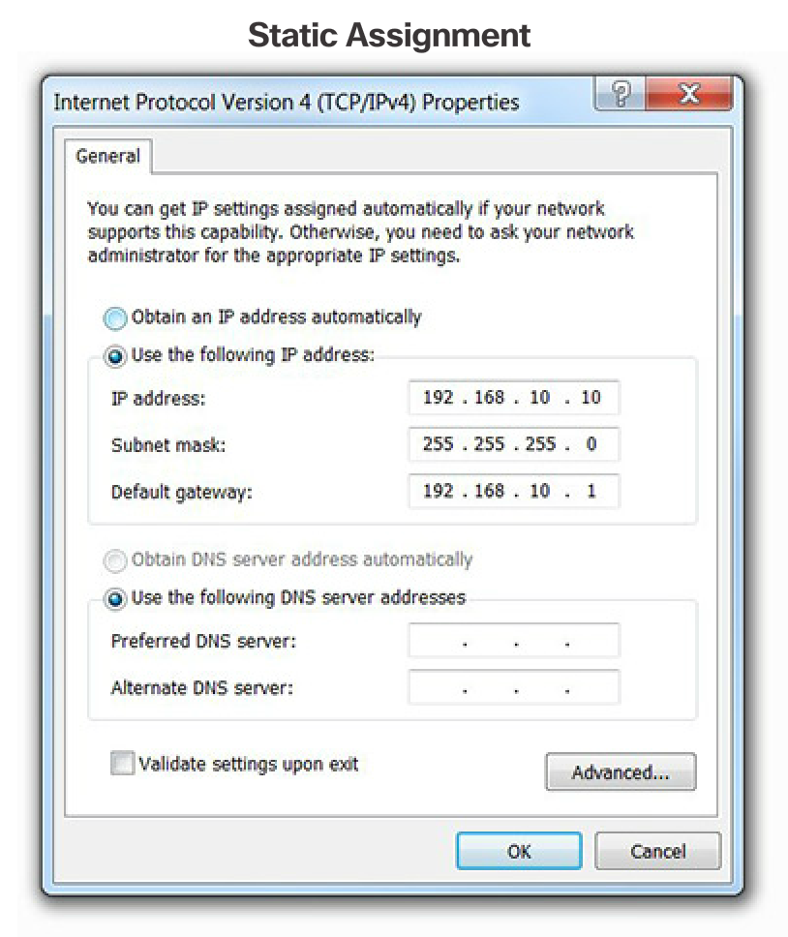
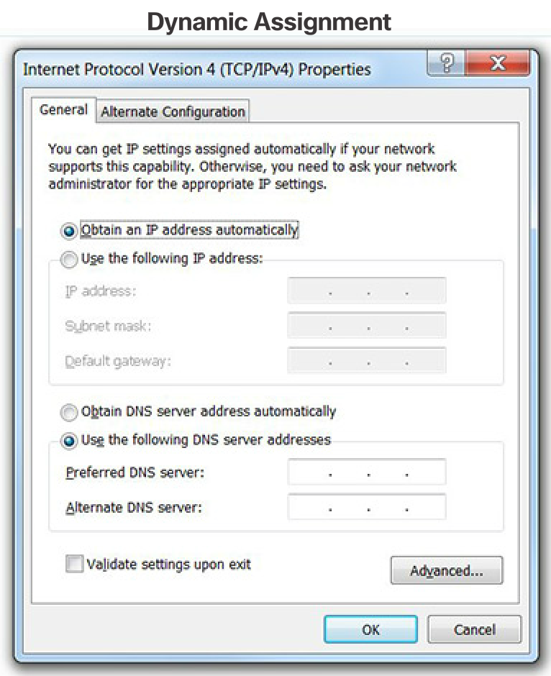
IPv4 Network Addresses
IPv4 Unicast, Broadcast, and Multicast
IPv4 Addressing Assignment to a Host
  Static – Type in manually
  Dynamic - Dynamic Host Configuration Protocol (DHCP)
Notes:
7.1 – IPv4 Network Addresses
7.1.3 – IPv4 Unicast, Broadcast, and Multicast

Slide 21
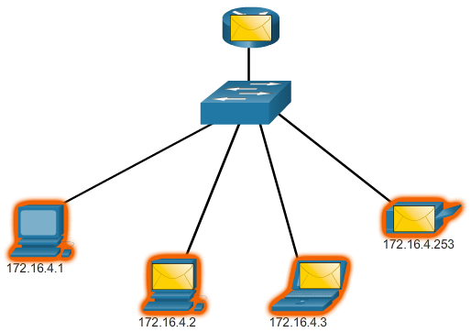
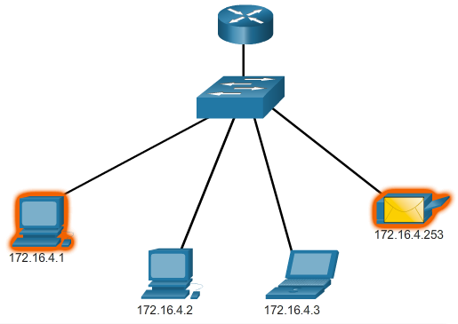
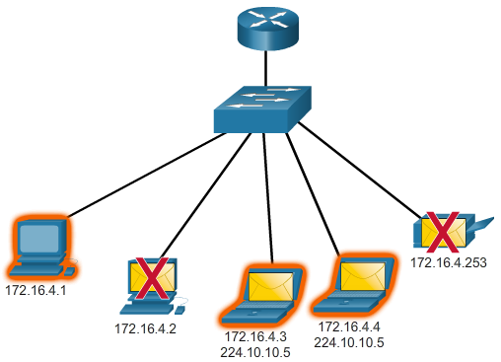
IPv4 Network Addresses
IPv4 Unicast, Broadcast, and Multicast
IPv4 Communication
  Unicast - send packets from one host to an individual host
  Broadcast - send packets from one host to all the hosts in the network
  Multicast - send a packet from one host to a selected group of hosts in the same or different network.
    224.0.0.0 to 239.255.255.255 IPv4 addresses as multicast range.
    224.0.0.0 to 224.0.0.255 multicast for local only.
  Which types of communication are the graphics on the right?
Notes:
7.1 – IPv4 Network Addresses
7.1.3 – IPv4 Unicast, Broadcast, and Multicast

Slide 22
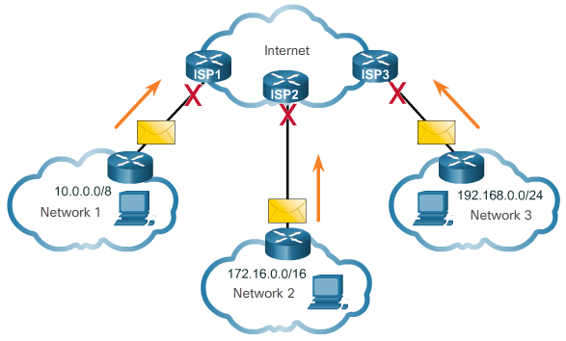

IPv4 Network Addresses
Types of IPv4 Addresses
Public and Private IPv4 Addresses
  Public IPv4 addresses are addresses which are globally routed between ISP (Internet Service Provider) routers.
  Private addresses are not routed over the Internet
  Private Addresses:
    10.0.0.0/8 or 10.0.0.0 to10.255.255.255
    172.16.0.0 /12 or 172.16.0.0 to 172.31.255.255
    192.168.0.0 /16 or 192.168.0.0 to 192.168.255.255
Special User IPv4 Addresses
  Loopback addresses
    127.0.0.0 /8 or 127.0.0.1 to 127.255.255.254
  Link-Local addresses or Automatic Private IP Addressing (APIPA) addresses
    169.254.0.0 /16 or 169.254.0.1 to 169.254.255.254
  TEST-NET addresses
    192.0.2.0/24 or 192.0.2.0 to 192.0.2.255
Notes:
7.1 – IPv4 Network Addresses
7.1.4 – Types of IPv4 Addresses

Slide 23
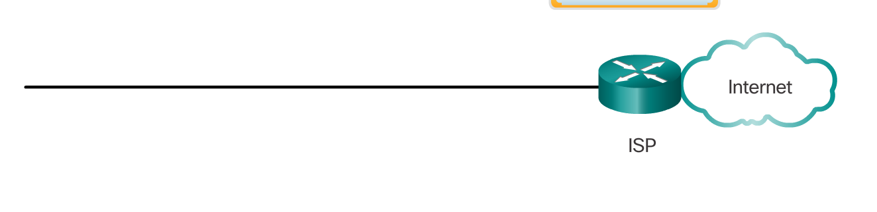
IPv4 Network Addresses
Activity – Private or Public IP Address
Determine if the IPv4 addresses below will be block or let it pass by an ISP before going to the Internet.
IP Address | Block or Pass?
56.1.10.20
10.8.9.7
192.168.10.5
172.22.15.200
220.4.5.6
11.12.13.14
172.17.18.19
10.254.254.254
Notes:
7.1 – IPv4 Network Addresses
7.1.2 – IPv4 Address Structure

Slide 24
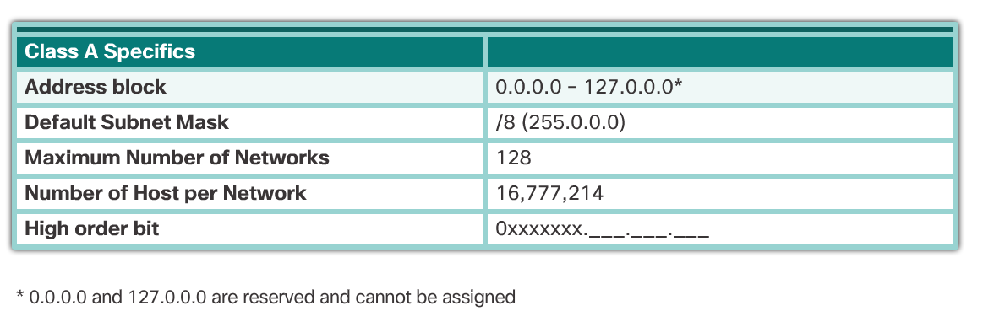
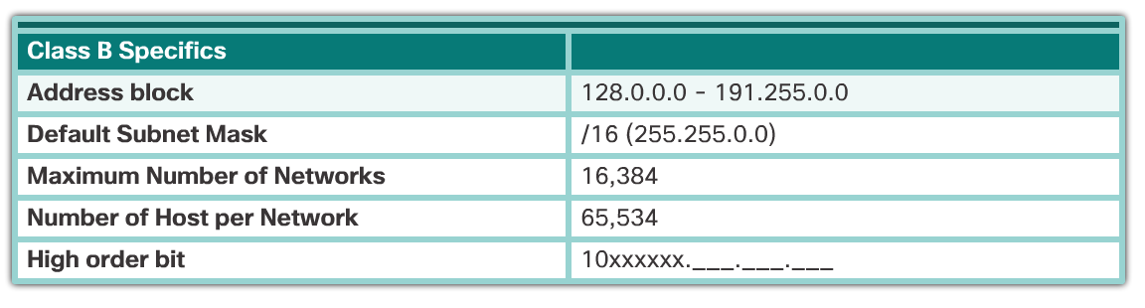
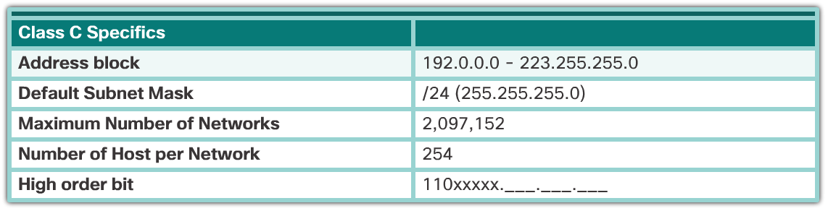
IPv4 Network Addresses
Types of IPv4 Addresses
Legacy Classful IPv4 Addressing
  Started around 1981 but abandoned around late 1990s
Notes:
7.1 – IPv4 Network Addresses
7.1.4 – Types of IPv4 Addresses

Slide 25
IPv4 Network Addresses
Types of IPv4 Addresses
Classless Addressing
  Classful was impractical for some networks does not need really large pool of IP addresses. Additionally, IPv4 is fast depleting because of Classful addressing scheme. So, then comes Classless Addressing.
  The formal name is Classless Inter-Domain Routing (CIDR, pronounced “cider”). In 1993, the IETF created a new set of standards that allowed service providers to allocate IPv4 addresses on any address bit boundary (prefix length) instead of only by a class A, B, or C address.
  Allocated IPv4 addresses based on prefix length
Assignment of IP Addresses
Notes:
7.1 – IPv4 Network Addresses
7.1.4 – Types of IPv4 Addresses

Slide 26
7.2 IPv6 Network Addresses
Notes:
Cisco Networking Academy Program
Introduction to Networks v6.0
Chapter 7: IP Addressing

Slide 27
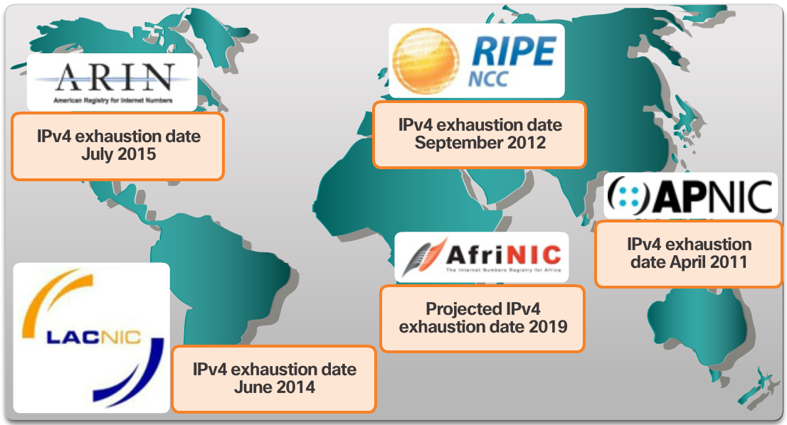
IPv6 Network Addresses
IPv4 Issues
The Need for IPv6
  Depletion of IPv4 address space
  Internet of Everything - The evolving Internet is becoming an Internet of things. No longer will the only devices accessing the Internet be computers, tablets, and smartphones. The sensor-equipped, Internet-ready devices of tomorrow will include everything from automobiles and biomedical devices, to household appliances and natural ecosystems.
  Unlike IPv4 which 32 bits IPv6 is 128 bits.
  IPv4 is approximately 4.2 Billion IP Addresses but IPv6 is 340 undecillion (340 followed by 36 zeros) addresses.
Notes:
7.2 – IPv6 Network Addresses
7.2.1 – IPv4 Issues

Slide 28
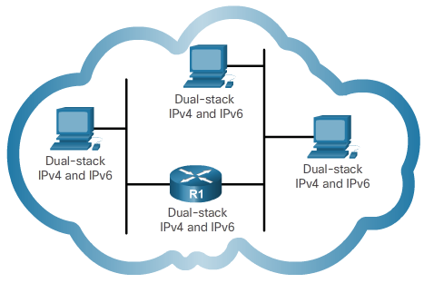
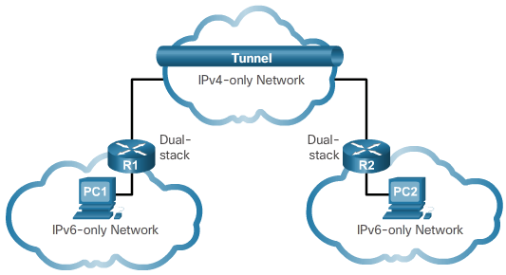
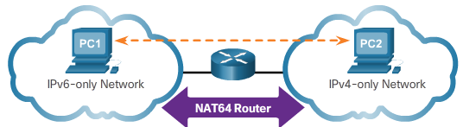
IPv6 Network Addresses
IPv4 Issues
IPv4 and IPv6 Coexistence
  Dual Stack – allows IPv4 and IPv6 to coexist on the same network segment. Dual stack devices run both IPv4 and IPv6 protocol stacks simultaneously.
  Tunneling – IPv6 packets is encapsulated inside IPv4 packets
  Translation - IPv6 packet is translated to an IPv4 packet, and vice versa.
Notes:
7.2 – IPv6 Network Addresses
7.2.1 – IPv4 Issues

Slide 29
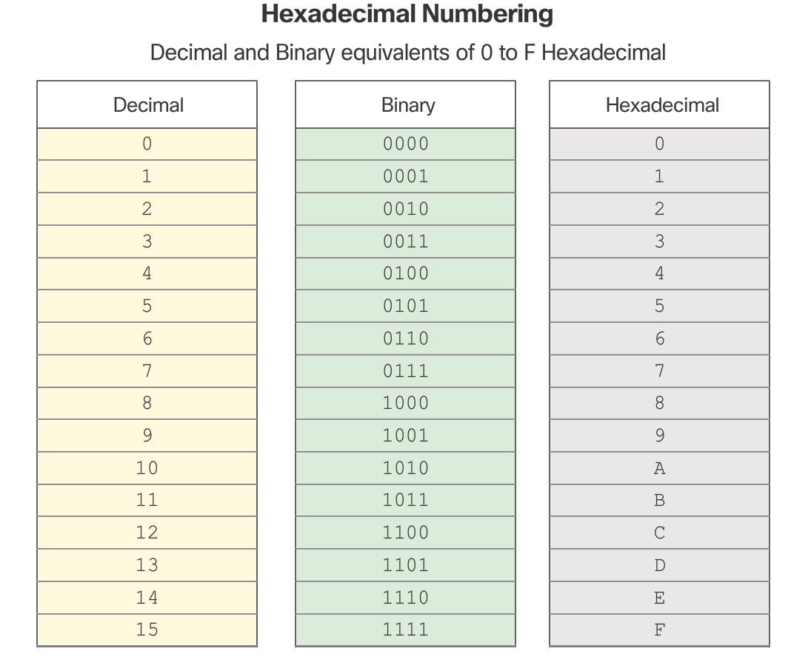
IPv6 Network Addresses
IPv6 Addressing
IPv6 Address Representation
  x:x:x:x:x:x:x:x, where x represents 4 hexadecimal values.
  Hexadecimal values are from 0 to F.
  Example of an IPv6 address:
  2001:0DB8:FE08:0001:FF00:DEF2:0203:CAFE
Notes:
7.2 – IPv6 Network Addresses
7.2.2 – IPv6 Addressing

Slide 30
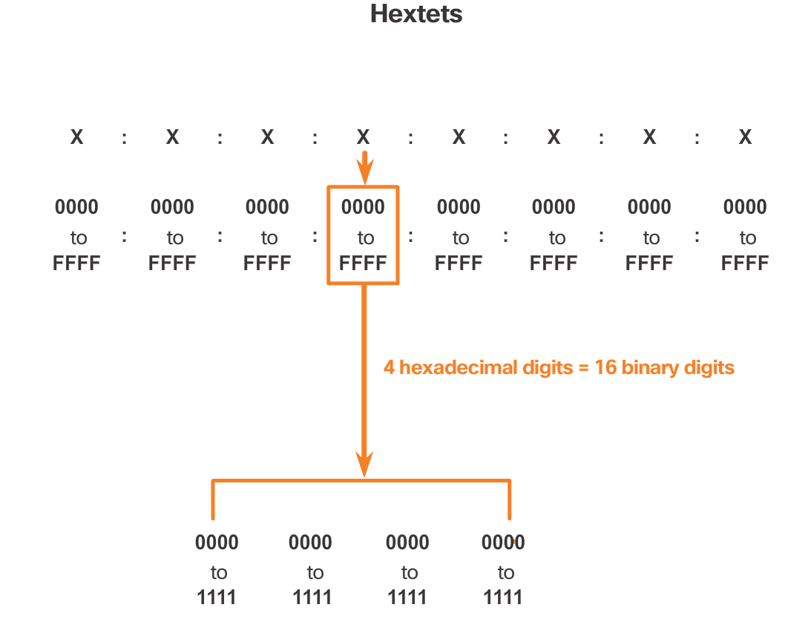
IPv6 Network Addresses
IPv6 Addressing
IPv6 Address Representation
  x:x:x:x:x:x:x:x, where x represents 4 hexadecimal values.
  Each hexadecimal values is 4 bits and since there are 4 hexadecimal values, you end up with 16 bits for each x, which is otherwise known as hextets.
Notes:
7.2 – IPv6 Network Addresses
7.2.2 – IPv6 Addressing

Slide 31
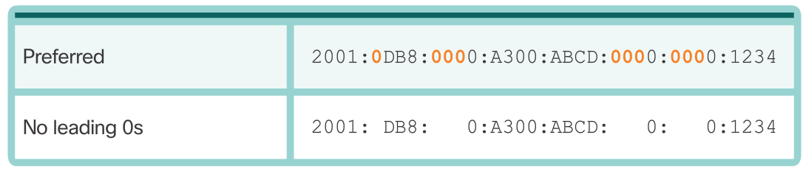
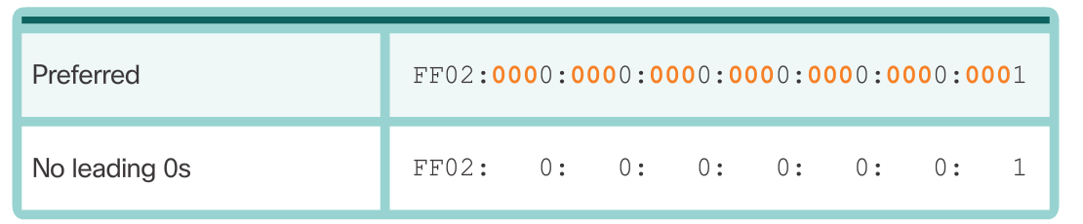
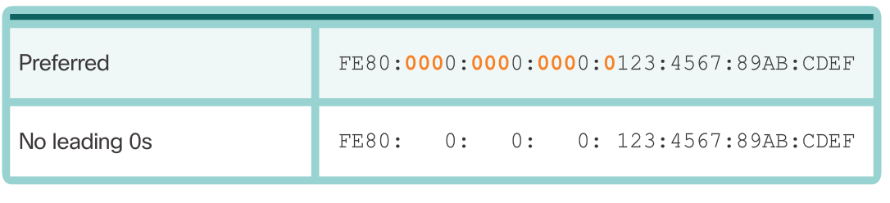
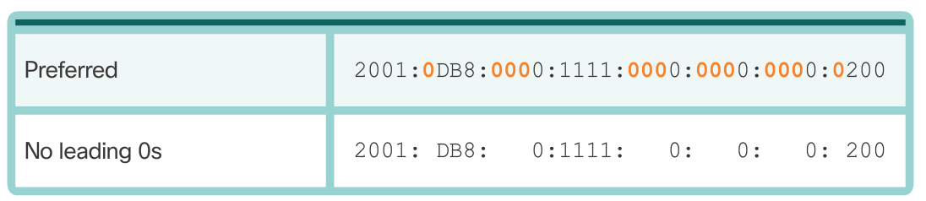
IPv6 Network Addresses
IPv6 Addressing Rule on compression
Rule 1: Omit Leading 0s
Notes:
7.2 – IPv6 Network Addresses
7.2.2 – IPv6 Addressing

Slide 32
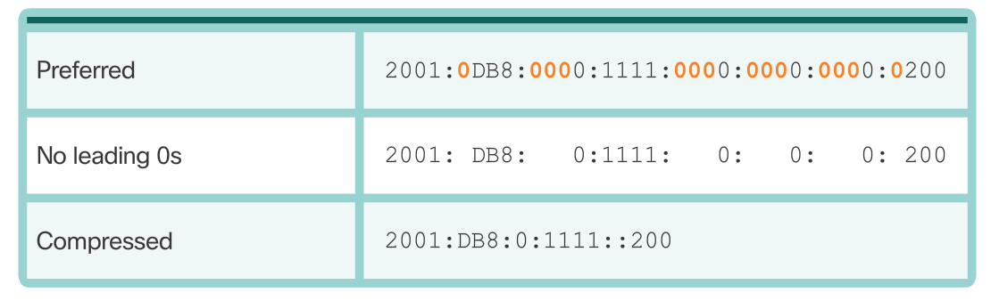
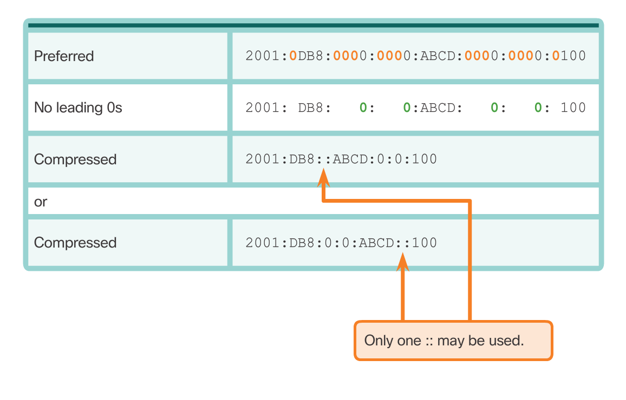
IPv6 Network Addresses
IPv6 Addressing
Rule 2: Omit All 0 Segments
Notes:
7.2 – IPv6 Network Addresses
7.2.2 – IPv6 Addressing

Slide 33
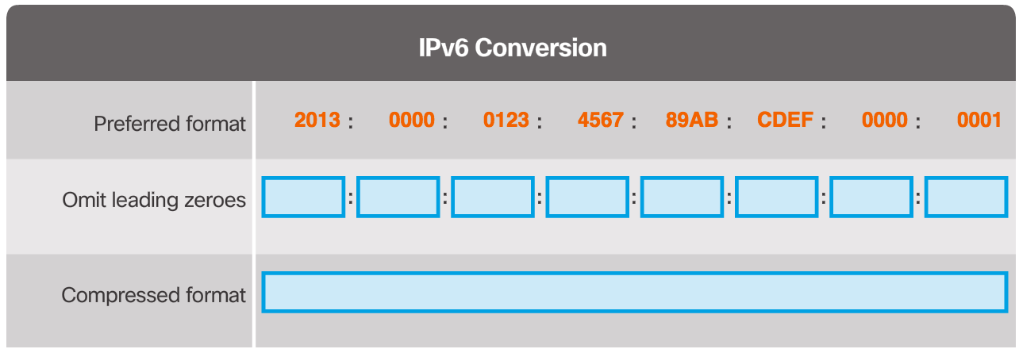
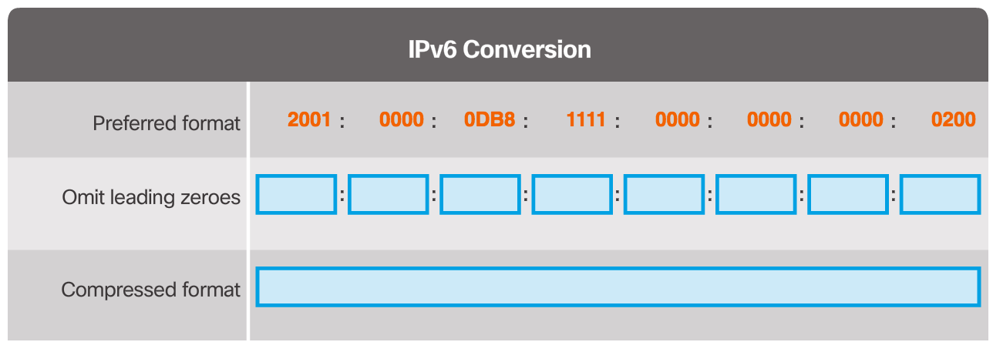
IPv6 Network Addresses
Activity – IPv6 Compression
Notes:
7.1 – IPv4 Network Addresses
7.1.2 – IPv4 Address Structure

Slide 34
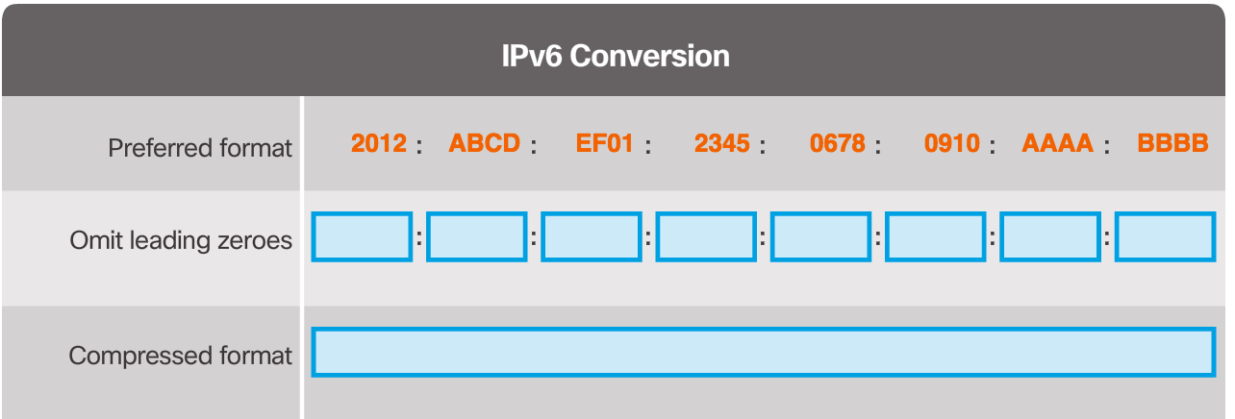
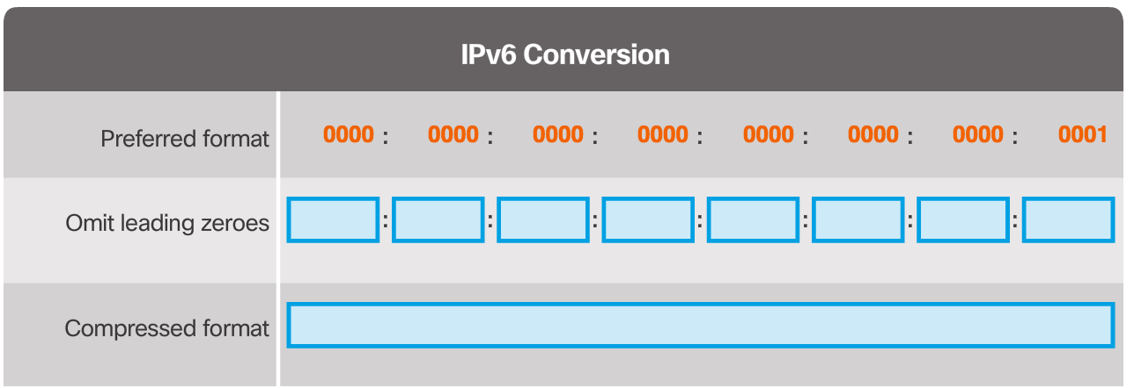
IPv6 Network Addresses
Activity – IPv6 Compression
Notes:
7.1 – IPv4 Network Addresses
7.1.2 – IPv4 Address Structure

Slide 35
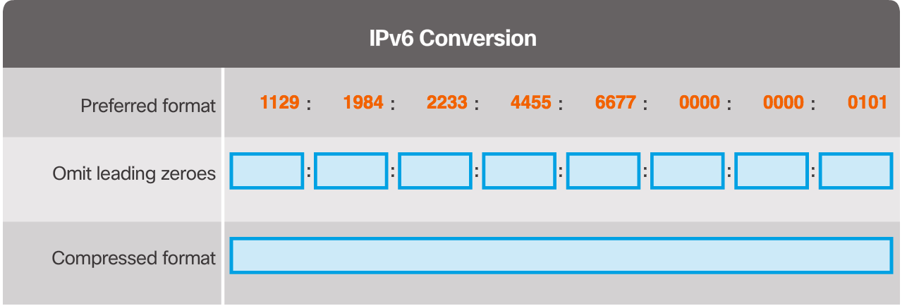
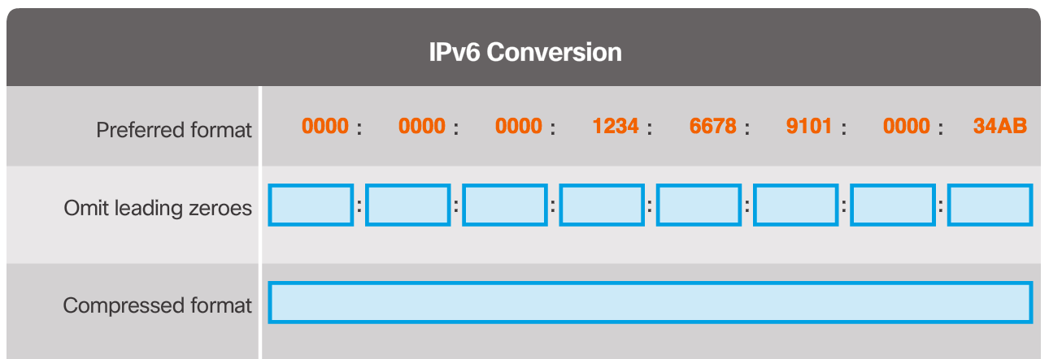
IPv6 Network Addresses
Activity – IPv6 Compression
Notes:
7.1 – IPv4 Network Addresses
7.1.2 – IPv4 Address Structure

Slide 36
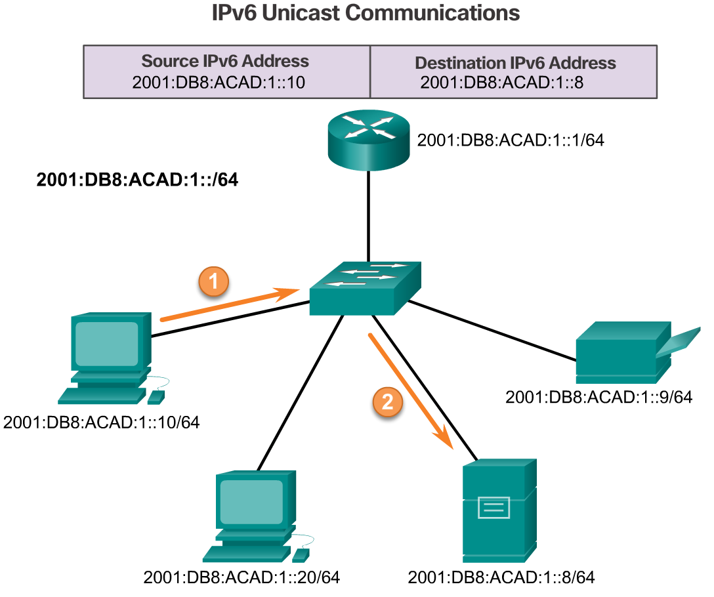
IPv6 Network Addresses
Types of IPv6 Addresses
IPv6 Address Types
  Unicast - An IPv6 unicast address uniquely identifies an interface on an IPv6-enabled device.
  Multicast - An IPv6 multicast address is used to send a single IPv6 packet to multiple destinations.
  Anycast - An IPv6 anycast address is any IPv6 unicast address that can be assigned to multiple devices. A packet sent to an anycast address is routed to the nearest device having that address.
Notes:
7.2 – IPv6 Network Addresses
7.2.3 – Types of IPv6 Addresses

Slide 37
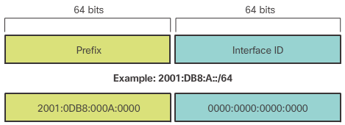
IPv6 Network Addresses
Types of IPv6 Addresses
IPv6 Prefix Length
  Indicates the network portion
  Format: IPv6 address /prefix length
  Prefix length range from 0 to 128
  Typical length is /64
Notes:
7.2 – IPv6 Network Addresses
7.2.3 – Types of IPv6 Addresses

Slide 38
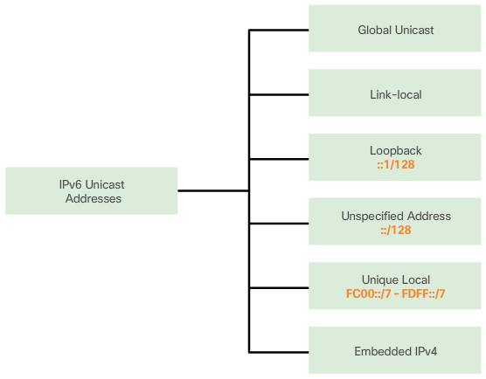
IPv6 Network Addresses
Types of IPv6 Addresses
Common Types of IPv6 Addresses
  Global Unicast Addresses (GUA)
    Similar to IPv4 public IP address
    Unique, Internet routable addresses
    Configured statically or assigned dynamically.
    They are in the range 2000::/3 to 3FFF::/3 for the meantime
  Link-Local Unicast Addresses
    Communicate with other IPv6 enabled devices on the same link or subnet.
    They are confined to a single link.
    They are not routable unlike GUA.
    Device creates its own link local address without DHCP server
  Unique Local Addresses
    Unique local unicast
    Almost similar to IPV4 private IP addresses
    Used for local addresses within a site or between a limited number of sites
    They are in the range of FC00::/7 to FDFF::/7.
Notes:
7.2 – IPv6 Network Addresses
7.2.3 – Types of IPv6 Addresses

Slide 39


IPv6 Network Addresses
Link-Local Unicast Addresses
Common Types of IPv6 Addresses
  Link-Local Unicast Addresses
    Communicate with other IPv6 enabled devices on the same link or subnet.
    They are confined to a single link.
    They are not routable unlike GUA.
    Every IPv6-enabled network interface is required to have a link-local address even if it does not have a GUA.
    Device creates its own link local address without DHCP server.
    IPv6 link-local addresses are in the FE80::/10 range. The /10 indicates that the first 10 bits are 1111 1110 10xx xxxx. The first hextet has a range of 1111 1110 1000 0000 (FE80) to 1111 1110 1011 1111 (FEBF).
Notes:
7.2 – IPv6 Network Addresses
7.2.3 – Types of IPv6 Addresses

Slide 40

IPv6 Network Addresses
Activity – Identify types of IPv6 Addresses
Identify if the IPv6 addresses below is either Global Unicast Address, Link-Local Address or /64 Address
Notes:
7.1 – IPv4 Network Addresses
7.1.2 – IPv4 Address Structure

Slide 41


IPv6 Network Addresses
IPv6 Unicast Addresses
Structure of an IPv6 Global Unicast Address
  Global Routing Prefix - the global routing prefix is the prefix, or network, portion of the address that is assigned by the provider, such as an ISP, to a customer or site. Typically, RIRs assign a /48 global routing prefix to customers.
Notes:
7.2 – IPv6 Network Addresses
7.2.4 – IPv6 Unicast Addresses

Slide 42
IPv6 Network Addresses
IPv6 Unicast Addresses
Structure of an IPv6 Global Unicast Address
  Global Routing Prefix
  Subnet ID - The Subnet ID is used by an organization to identify subnets within its site. The larger the subnet ID, the more subnets available.
  Interface ID - The IPv6 Interface ID is equivalent to the host portion of an IPv4 address. The term Interface ID is used because a single host may have multiple interfaces, each having one or more IPv6 addresses. It is highly recommended that in most cases /64 subnets should be used.
Notes:
7.2 – IPv6 Network Addresses
7.2.4 – IPv6 Unicast Addresses

Slide 43


IPv6 Network Addresses
Configuring IPv6 in a router and a PC
Static Configuration of a Global Unicast Address
  Most IPv6 configuration and verification commands in the Cisco IOS are similar to their IPv4 counterparts. In many cases, the only difference is the use of ipv6 in place of ip within the commands.
  ipv6 address ipv6-address/prefix-length
Notes:
7.2 – IPv6 Network Addresses
7.2.4 – IPv6 Unicast Addresses

Slide 44

IPv6 Network Addresses
Dynamic Configuration - SLAAC
SLAAC
  Stateless Address Autoconfiguration (SLAAC) is a method that allows a device to obtain its prefix, prefix length, default gateway address, and other information from an IPv6 router without the use of a DHCPv6 server. Using SLAAC, devices rely on the local router’s ICMPv6 Router Advertisement (RA) messages to obtain the necessary information.
  IPv6 routers periodically send out ICMPv6 RA messages, every 200 seconds, to all IPv6-enabled devices on the network. An RA message will also be sent in response to a host sending an ICMPv6 Router Solicitation (RS) message.
Notes:
7.2 – IPv6 Network Addresses
7.2.4 – IPv6 Unicast Addresses

Slide 45

IPv6 Network Addresses
Dynamic Configuration – SLAAC (cont’d)
ICMPv6 - The ICMPv6 RA message is a suggestion to a device on how to obtain an IPv6 global unicast address. The ultimate decision is up to the device’s operating system. The ICMPv6 RA message includes:
Network prefix and prefix length – Tells the device which network it belongs to.
Default gateway address – This is an IPv6 link-local address, the source IPv6 address of the RA message.
DNS addresses and domain name – Addresses of DNS servers and a domain name.
Notes:
7.2 – IPv6 Network Addresses
7.2.4 – IPv6 Unicast Addresses

Slide 46
IPv6 Network Addresses
Dynamic Configuration – SLAAC (cont’d)
3 options for RA messages
  Option 1 (SLAAC): By default, the RA message suggests that the receiving device use the information in the RA message to create its own IPv6 global unicast address and for all other information. The services of a DHCPv6 server are not required.
Notes:
7.2 – IPv6 Network Addresses
7.2.4 – IPv6 Unicast Addresses

Slide 47

IPv6 Network Addresses
Dynamic Configuration – SLAAC (cont’d)
3 options for RA messages
Option 2 (SLAAC and Stateless DHCPv6): With this option, the RA message suggests devices use:
  SLAAC to create its own IPv6 global unicast address
  The router’s link-local address, the RA’s source IPv6 address for the default gateway address.
  A stateless DHCPv6 server to obtain other information such as a DNS server address and a domain name.
A stateless DHCPv6 server distributes DNS server addresses and domain names. It does not allocate global unicast addresses.
Notes:
7.2 – IPv6 Network Addresses
7.2.4 – IPv6 Unicast Addresses

Slide 48
IPv6 Network Addresses
Dynamic Configuration – SLAAC (cont’d)
3 options for RA messages
Option 3 (Stateful DHCPv6): Stateful DHCPv6 is similar to DHCP for IPv4. A device can automatically receive its addressing information including a global unicast address, prefix length, and the addresses of DNS servers using the services of a stateful DHCPv6 server. With this option the RA message suggests devices use:
  The router’s link-local address, the RA’s source IPv6 address for the default gateway address.
  A stateful DHCPv6 server to obtain a global unicast address, DNS server address, domain name and all other information.
A stateful DHCPv6 server allocates and maintains a list of which device receives which IPv6 address. DHCP for IPv4 is stateful.
Notes:
7.2 – IPv6 Network Addresses
7.2.4 – IPv6 Unicast Addresses

Slide 49
IPv6 Network Addresses
Dynamic Configuration – EUI-64
When the RA message is either SLAAC or SLAAC with stateless DHCPv6, the client must generate its own Interface ID. The client knows the prefix portion of the address from the RA message but must create its own Interface ID. The Interface ID can be created using the EUI-64 process or a randomly generated 64-bit number.
IEEE defined the Extended Unique Identifier (EUI) or modified EUI-64 process. This process uses a client’s 48-bit Ethernet MAC address, and inserts another 16 bits in the middle of the 48-bit MAC address to create a 64-bit Interface ID.
Notes:
7.2 – IPv6 Network Addresses
7.2.4 – IPv6 Unicast Addresses

Slide 50
IPv6 Network Addresses
Dynamic Configuration – EUI-64 (cont’d)
Ethernet MAC addresses are usually represented in hexadecimal and are made up of two parts:
  Organizationally Unique Identifier (OUI) – The OUI is a 24-bit (6 hexadecimal digits) vendor code assigned by IEEE.
  Device Identifier – The device identifier is a unique 24-bit (6 hexadecimal digits) value within a common OUI.
An EUI-64 Interface ID is represented in binary and is made up of three parts:
  24-bit OUI from the client MAC address, but the 7th bit (the Universally/Locally (U/L) bit) is reversed. This means that if the 7th bit is a 0, it becomes a 1, and vice versa.
  The inserted 16-bit value FFFE (in hexadecimal)
  24-bit Device Identifier from the client MAC address
Notes:
7.2 – IPv6 Network Addresses
7.2.4 – IPv6 Unicast Addresses

Slide 51

IPv6 Network Addresses
Dynamic Configuration – EUI-64 (cont’d)
The EUI-64 process is illustrated on the right figure, using MAC address of FC99:4775:CEE0.
  Step 1: Divide the MAC address between the OUI and device identifier.
  Step 2: Insert the hexadecimal value FFFE, which in binary is: 1111 1111 1111 1110.
  Step 3: Convert the first 2 hexadecimal values of the OUI to binary and flip the U/L bit (bit 7). In this example, the 0 in bit 7 is changed to a 1.
The result is an EUI-64 generated Interface ID of FE99:47FF:FE75:CEE0.
Notes:
7.2 – IPv6 Network Addresses
7.2.4 – IPv6 Unicast Addresses

Slide 52

IPv6 Network Addresses
Dynamic Configuration – EUI-64 (cont’d)
The EUI-64 process is illustrated on the right figure, using MAC address of FC99:4775:CEE0.
  Step 1: Divide the MAC address between the OUI and device identifier.
  Step 2: Insert the hexadecimal value FFFE, which in binary is: 1111 1111 1111 1110.
  Step 3: Convert the first 2 hexadecimal values of the OUI to binary and flip the U/L bit (bit 7). In this example, the 0 in bit 7 is changed to a 1.
The result is an EUI-64 generated Interface ID of FE99:47FF:FE75:CEE0.
Notes:
7.2 – IPv6 Network Addresses
7.2.4 – IPv6 Unicast Addresses

Slide 53


IPv6 Network Addresses
IPv6 Multicast Addresses
Assigned IPv6 Multicast Addresses
  IPv6 multicast addresses have the prefix FF00::/8
    FF02::1 All-nodes multicast group
    FF02::2 All-routers multicast group
Solicited-Node IPv6 Multicast Addresses
Notes:
7.2 – IPv6 Network Addresses
7.2.5 – IPv6 Multicast Addresses

Slide 54
7.3 Connectivity Verification
Notes:
Cisco Networking Academy Program
Introduction to Networks v6.0
Chapter 7: IP Addressing

Slide 55

Connectivity Verification
ICMP
ICMPv4 and ICMPv6
  Host Confirmation
  Destination or Service Unreachable
  Time Exceeded
  Router Redirection
ICMPv6 Router Solicitation and Router Advertisement Messages
  Messaging between an IPv6 router and an IPv6 device:
    Router Solicitation (RS) message
    Router Advertisement (RA) message
  Messaging between IPv6 devices:
    Neighbor Solicitation (NS) message
    Neighbor Advertisement (NA) message
  Duplicate Address Detection (DAD)
Notes:
7.3 – Connectivity Verification
7.3.1 – ICMP

Slide 56

Connectivity Verification
Testing and Verification
Ping
  Testing the Local Stack
    127.0.0.1 (IPv4) or ::1 (IPv6)
  Testing Connectivity to the Local LAN
  Testing Connectivity to Remote
Traceroute
  Testing the Path
    Round Trip Time (RTT)
    IPv4 TTL and IPv6 Hop Limit
Notes:
7.3 – Connectivity Verification
7.3.2 – Testing and Verification

Slide 57
7.4 Chapter Summary
Notes:
Cisco Networking Academy Program
Introduction to Networks v6.0
Chapter 7: IP Addressing

Slide 58
Chapter Summary
Summary
Explain the use of IPv4 addresses to provide connectivity in a small to medium-sized business network.
Configure IPv6 addresses to provide connectivity in small to medium-sized business networks.
Use common testing utilities to verify network connectivity.
Notes:
7.4.1.3 - Summary

Slide 60


Slide 61
Section 7.1
New Terms and Commands
ANDing
Binary Numbering System
Broadcast
Broadcast Address
Broadcast Domain
Class A
Class B
Class C
Class D
Class E
Classless Inter-domain Routing (CIDR)
DHCP Server
DHCP Client Dynamic Assignment
Directed Broadcast
Dotted Decimal Format
Dynamic Host Configuration Protocol (DHCP)
Host Address
Internet Assigned Numbers Authority (IANA)
Internet Service Providers (ISPs)
IPv4 Loopback Address
Limited Broadcast
Link-local Addresses
Multicast Transmission
Multicast
Multicast Addresses
Network Address
Octet
Positional Notation
Prefix Length
Private Address
Public Address
radix
Regional Internet Registries (RIRs)
RFC 1918
Slash Notation
Static IP Addressing
Subnet Mask
TEST-NET Addresses
Unicast
Notes:
New Terms and Commands

Slide 62
Section 7.2
New Terms and Commands
Address Resolution
Assigned multicast
Destination or Service Unreachable
Dual-stack
Duplicate Address Detection
EUI-64 Process
FF02::1 All-nodes multicast group
FF02::2 All-routers multicast group
Global Unicast Address
Hextet
Host confirmation
ICMPv6
IPv4 Time-to-Live (TTL)
IPv6
IPv6 Anycast
IPv6 Hop Limit
IPv6 link-local address
IPv6 Loopback Address
IPv6 Multicast
IPv6 Prefix Length
IPv6 Unicast
Leading Zeros
Link-local Address
Network Address Translation (NAT64)
Round Trip Time (RTT)
Route redirection
Router Advertisement
Router Solicitation
show ipv6 interface brief
show ipv6 route
Solicited node multicast
Stateless Address Autoconfiguration (SLAAC)
Time exceeded
Tunneling
Unique Local Address
Unspecified Address
Notes:
New Terms and Commands

